Slide 1
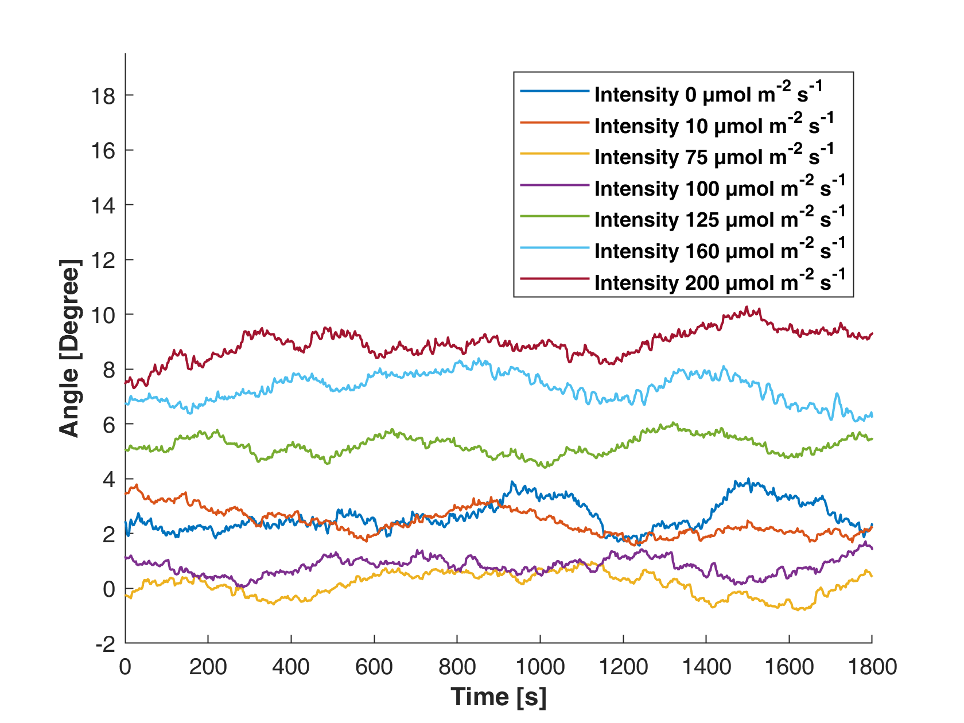
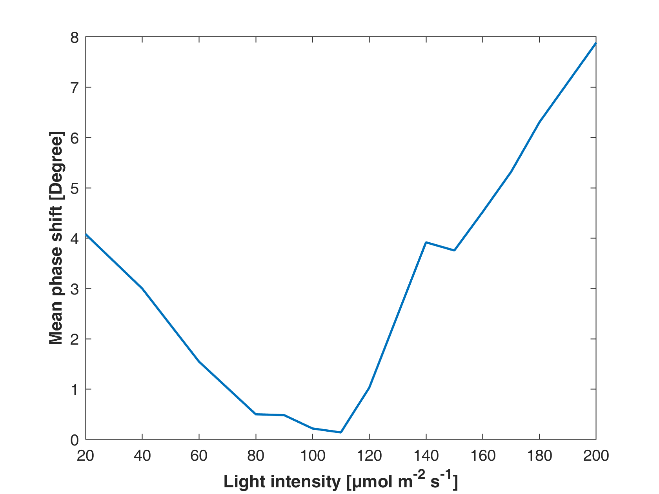
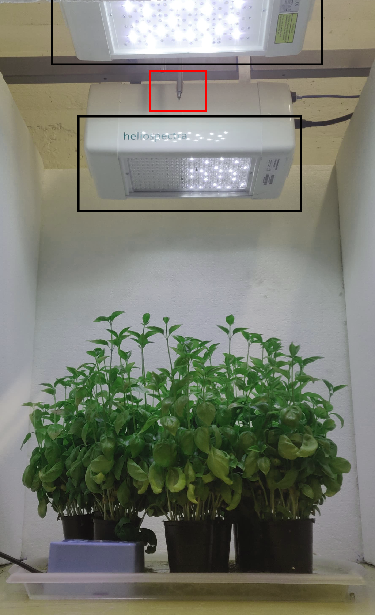
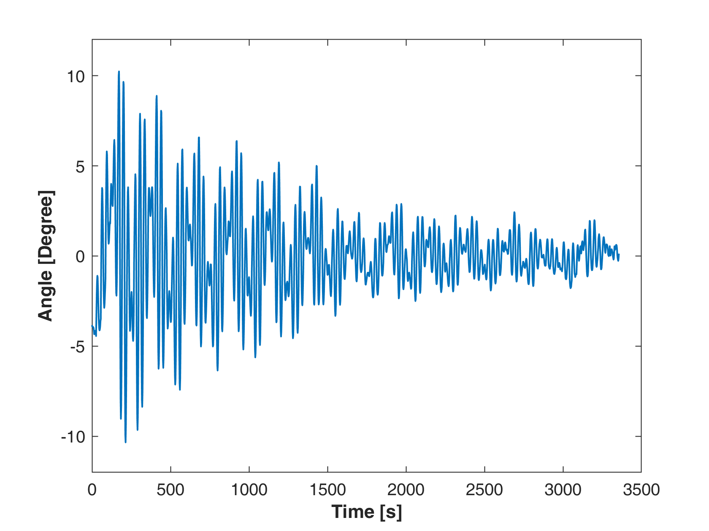
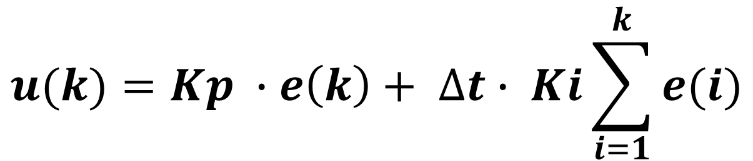
Greenhouse lighting control by chlorophyll fluorescence
Annie Edvardsson & Indrek Kivi
Project Course
By measuring the plants stress level, with respect to the light intensity, the well-being of plants can be appraised.
The stress level can be estimated by calculating the phase shift between a sinusoidal excitation signal and the chlorophyll fluorescence signal plants emit.
If optimal phase shift is known, it can be used as a setpoint for control. The controller changes the light intensity by minimizing the error between the setpoint and estimated phase shift. This way stress can be minimized and growth maximized and light used efficiently.
Phase estimation
The phase shift was estimated for multiple light intensities:
The phase shift over time for different light intensities
Mean value of the phase shift with different intensities
With this data it was confirmed that the phase shift changes with the light intensity and therefore it is possible to control it. A phase shift setpoint was defined at 4 degrees (RHS of the graph), where the system is approximately linear.
Set-up of experiment
Controller
A PI-controller was created to minimize the phase error. The controller in discrete time is defined as:
$$u(k)=Kp ∙e\left(k\right)+ ∆t∙ Ki\sum_{i=1}^{k}{e(i)}$$
An experiment was made testing the whole system. The controller then manages to stabilize the system and maintain the error around zero degrees. This result can be seen below.
The Figure shows the experiment set-up. The black boxes views the LED lamps and the red box views the spectrometer sensor

